Slide 1

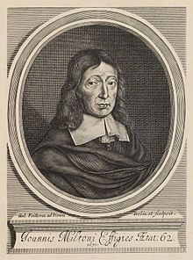
John Milton
(1608-1674)
On the Morning of Christ's Nativity
On Shakespeare
L'Allegro
II Penseroso
Lycidas
The Reason of Church Government Urged Against Prelaty
Areopagitica
Sonnets

Slide 2
Life
Son of a wealthy scrivener.
Educated at St. Paul’s School and Cambridge
At Cambridge he wrote poetry in Latin and English
Planned to become a minister in the Church but later gave up
Lived in his father’s estate and devoted himself to studies
He wrote masques named Comus and Lycidas, one of his best poems, an elegy on the death of his fellow friend Edward King
In 1638 he went to Italy. Travelled, studies and met many famous poeple there.
He supported Presbyterians
  Of Reformation in England (1641)

Slide 3
He married Mary Powell but she left him.
Disillusioned by this marriage he wrote pamphlets on divorce
Areopagitica (1644), freedom of speech, consorship by the parliament
In time he left the Presbyterian Church
The Tenure of Kings and Magistrates 1649
  Supported the imprisonment of Charles I
  Cromwell granted him a position in the Parliament
  Latin secretary for foreign affairs
  Eikonoklastes 1649
  First Defence of the English People 1651
  Second Defence of the English People 1654
  Defence of Himself 1655
Because of heavy office work and pamphleteering he became totally blind. He used secretaries to continue work.

Slide 4
Mary Powell remarried him. They had three daughters. Married two more times
After Restoration he had to hide for a while. His books were burned because of Commonweath support.
WORKS
Milton wrote masterful long poems
Wrote in all genres at the time
He had a firm poetic foundation through his intense study of languages, philosophy and politics fused with uncanny tone and diction.
His faith in God was prominent in those works.
He believed that poetry served a social, philosophical, and religious purpose.
He thought that poetry should glorify God, promote religious values, enlighten readers and help people to become better Christians.

Slide 5
Works
Poetry and drama
1629: On the Morning of Christ's Nativity
1630: On Shakespeare
1631: On Arriving at the Age of Twenty-Three
1632: L'Allegro
1632: Il Penseroso
1634: Comus (a masque)
1637: Lycidas
1645: Poems of Mr John Milton, Both English and Latin
1652: When I Consider How My Light is Spent
1655: On the Late Massacre in Piedmont
1667: Paradise Lost
1671: Paradise Regained
1671: Samson Agonistes
1673: Poems, &c, Upon Several Occasions

Slide 6
Prose
Of Reformation (1641)
Of Prelatical Episcopacy (1641)
The Reason of Church-Government Urged against Prelaty (1642)
Apology for Smectymnuus (1642)
Doctrine and Discipline of Divorce (1643)
Judgement of Martin Bucer Concerning Divorce (1644)
Of Education (1644)
Areopagitica (1644)
Tetrachordon (1645)
Colasterion (1645)
The Tenure of Kings and Magistrates (1649)
Eikonoklastes (1649)
Defensio pro Populo Anglicano [First Defence] (1651)
Defensio Secunda [Second Defence] (1654)
A Treatise of Civil Power (1659)
The Likeliest Means to Remove Hirelings from the Church (1659)
The Ready and Easy Way to Establish a Free Commonwealth (1660)
Brief Notes Upon a Late Sermon (1660)
Accedence Commenced Grammar (1669)
The History of Britain (1670)

Slide 7
POLITICS
Milton's political ideals are expressed in the many essays and pamphlets he wrote during his lifetime.
Milton championed the absolute freedom of the individual-perhaps because he had been so often betrayed by the institutions in which he put his trust. His distrust of institutions was accompanied by his belief that power corrupts human beings. He distrusted anyone who could claim power over anyone else and believed that rulers should have to prove their right to lead other people.
Although Milton championed liberty and fought against authority throughout his career, in theory he believed in a strict social and political hierarchy in which people would obey their leaders and leaders serve their people.
He believed that leaders should be leaders because they are better fit to rule than their subjects. But despite these rigid views of authority, Milton believed that the social hierarchy that actually existed in his day was extremely corrupt, and he directly challenged the rule of Charles I, the king of England during much of Milton' s lif etime. Milton argued that Charles was not, in fact, fit to lead his subjects because he did not possess superior faculties or virtues. Religion

Slide 8
Religion
Milton took public stances ona great number of issues, but most important to the reading of Paradise Lost are his positions on religion.
In Milton's time, the Anglican Church split into high Anglican, moderate Anglican, and Puritan or Presbyterian sects. Milton was a Presbyterian. This denomination called for the abolishment of bishops, an office that exists as part of the Catholic and Anglican churches. Milton, however, gradually took his views further, ultimately calling for the removal of all priests, whom he referred to as "hirelings."
Milton despised the corruption he saw in the Catholic Church, repeatedly attac.king it both in his poetry and prose. In Lycidas, he likens Catholics to hungry wolves leaping into a sheep' s pen.
Milton saw few problems with the division of Protestants into more and smaller denomimitions. Instead he thought that the fragmentation of churches was a sign of healthy self-examination, and believed that each individual Christian should be his own church, without any establishment to encumber him. These beliefs, expressed in a great number of pamphlets, prompted his break with the Presbyterians before 1650. From that point on, Milton advocated the complete abolishment of all church establishments, and kept his own private and individual religion, close to the Calvinism practised by Presbyterians but differing in some ways.

Slide 9
In his later years, Milton came to view all organised Christian churches, whether Anglican, Catholic or Presbyterian, as an obstacle to true faith He felt that the individual and his conscience ( or "right reason") was a much more powerful tool in interpreting the Word of God than the example set by a church.
Throughout Paradise Lost, Milton expresses the idea that Adam and Eve's fall from grace was actually fortunate, because it gives individual human beings the opportunity to redeem themselves by true repentance and faith.
The importance of remaining strong in one' s peersonal religious convictions, particularly in the face of widespread condemnation, is a major theme in the later books of Paradise Lost, as Michael shows Adam the vision of Enoch and Noah, two followers of God who risk death to stand up for him.
Paradise Lost also presents a number of Protestant Christian positions: the union of the Old and New Testaments, the unworthiness of mankind, and the importance of Christ's love in man's salvation.

Slide 10
Women and Marriage
• Much of Milton's social commentary in Paradise Lost focuses on the proper role of women.
• In Book IV. he makes clear that he does not think men and women are equals, alludıng to biblical passages that identify man as the master of woman.
• Although Milton viewed women as inferior to men, believing that wives should be subsersient to their husbands, he did not see himself as a woman-hater.
Milton’s views on marriage were received as shocing and heretical in his own time.

Slide 11
Milton from Norton Anthology
He was interested in self-scrutiny and authorship.
Dealt with the great questions of his time.
Public duties.
Went from writing pastoral to heroic poetry.
Inspired by Edmund Spenser
Used biblical and classical stories
Sponsored by his father.
Allied with the Puritans.
Left Church because of other people
Wrote for the Revolution and Cromwell
Became blind

Slide 13
Lycidas
Pastoral elegy on Edward King Milton’s friend
Edmund Spenser
Theocritus, Virgil, Petrarch
Shepherds
Shepherds as pastor
Lycidas enjoys a perfected pastoral existence

Slide 14
The Reason of Church Government Urged against Prelaty
Prelaty: government by bishops, religious administration
Attacks liturgy, bishops and Church of England
Milton had opponents in the church

Slide 15
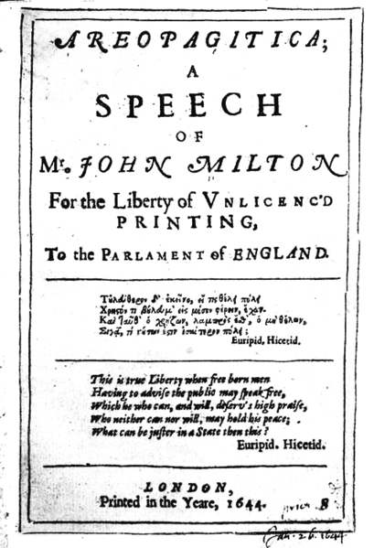
Areopagitica
Freedom of speech
Press Ordinance in 1643
Defense of intellectual liberty
Flood of pamphlets
Censorship laws
Publisher and author will be identified and fined and imprisoned if necessary
The clash and conflict of ideas should be allowed
Truth unveiled by this Milton thought
Religious toleration

Slide 16
Isocrates, his speech to the Areopagus, the Council of the Wise
Beneficial for reformation
«give me the liberty to know, to utter and to argue freely according to conscience, above all liberties»

Slide 17
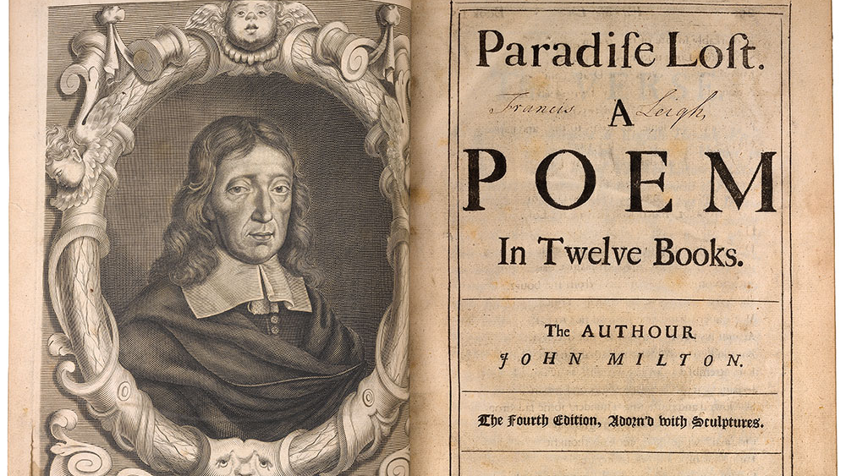
PARADISE LOST

Slide 18
Milton took public stances on a great number of issues, but most important to the reading of Paradise Lost are his positions on religion.
In Milton's time, the Anglican Church split into high Anglican, moderate Anglican, and Puritan or Presbyterian sects. Milton was a Presbyterian. This denomination called for the abolishment of bishops, an office that exists as part of the Catholic and Anglican churches. Milton, however, gradually took his views further, ultimately calling for the removal of all priests, whom he referred to as "hirelings."
Milton despised the corruption he saw in the Catholic Church, repeatedly attaciking it both in his poetry and prose. In Lycidas, he likens Catholics to hungry wolves leaping into a sheep' s pen.
Milton saw few problems with the division of Protestants into more and smaller denomimitions. Instead he thought that the fragmentation of churches was a sign of healthy self-examination, and believed that each individual Christian should be his own church, without any establishment to encumber him. These beliefs, expressed in a great number of pamphlets, prompted his break with the Presbyterians before 1650. From that point on, Milton advocated the complete abolishment of all church establishments, and kept his own private and individual religion, close to the Calvinism practised by Presbyterians but differing in some ways.

Slide 19
Throughout Paradise Lost, Milton expresses the idea that Adam and Eve's fall from grace was actually fortunate, because it gives individual human beings the opportunity to redeem themselves by true repentance and faith.
The importance of remaining strong in one' s personal religious convictions, particularly in the face of widespread condemnation, is a major theme in the later books of Paradise Lost, as Michael shows Adam the vision of Enoch and Noah, two followers of God who risk death to stand up for him.
Paradise Lost also presents a number of Protestant Christian positions: the union of the Old and New Testaments, the unworthiness of mankind, and the importance of Christ's love in man's salvation.

Slide 20
Battles and disagreements among spirits
The Fall that caused «all our woe»
Knowing choosing, free will
In medias res, invocation to the muses, Grand battles, love affairs, supernatural intervention, descent into the underworld, catalogs of warriors, epic similes
All that epic poetry needs is in Paradise Lost
The first and greatest of all wars
The fists and greatest of all love affairs
Expectations overturned by Milton. By critics Satan is considered as the true hero of the poem. According to Blake and Shelley
Hard choices under the pressure of powerful desires and sometimes devious temptations
  This linked to the English Revolution and Restoration
  Satan leads a revolution against system!

